Slide 1



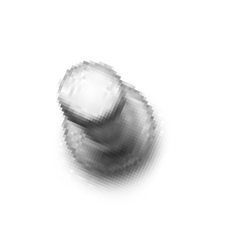
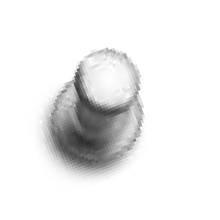



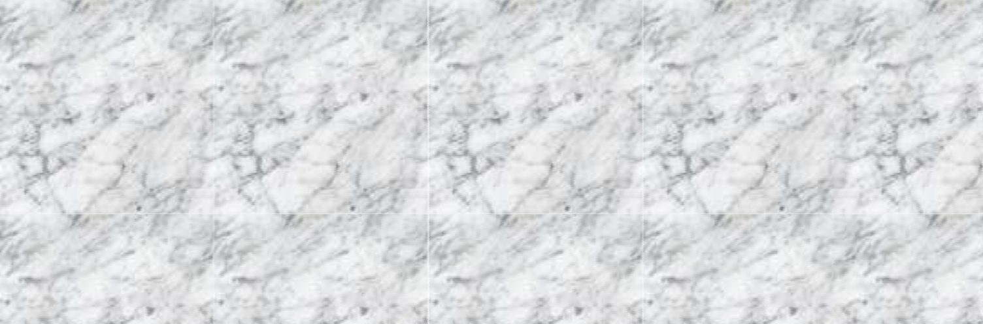















Slide 2
IMAGE ENHANCEMENT
OImage improve contrast and images.
enhancement is to
the brightness,
appearance of an

Slide 3
IMAGE ENHANCEMENT TECHNIQUES
IMAGE ENHANCEMENT
SPATIAL FILTERING
FREQUENCY FILTERING
SMOOTHING
SHARPENING
SMOOTHING
SHARPENING

Slide 4
Introduction To Filters
FILTER:
Filter is a process that removes some unwanted components or small details in a image.
TYPES OF FILTERS :
O SPATIAL DOMAIN FILTERS
O FREQUENCY DOMAIN FILTERS

Slide 5
Spatial Filtering
Background :
Filter term in “Digital image processing” is referred to the subimage
There are others term to call subimage such as mask, kernel, template, or window
The value in a filter subimage are referred as coefficients, rather than pixels.
Basics of Spatial Filtering :
The concept of filtering has its roots in the use of the Fourier transform for signal processing in the so -called frequency domain.
Spatial filtering term is the filtering operations that are
5

Slide 6
Spatial Filtering
Background :
Filter term in “Digital image processing” is referred to the subimage
There are others term to call subimage such as mask, kernel, template, or window
The value in a filter subimage are referred as coefficients, rather than pixels.
Basics of Spatial Filtering :
The concept of filtering has its roots in the use of the Fourier transform for signal processing in the so -called frequency domain.
Spatial filtering term is the filtering operations that are performed directly on the pixels of an image
5

Slide 7
Local enhancement through spatial filtering
The output intensity value at (x,y) depends not only on the input intensity value at (x,y) but also on the specified number of neighboring intensity values around (x,y)
Spatial masks (also called window, filter, kernel, template) are used and convolved over the entire image for local enhancement (spatial filtering)
The size of the masks determines the number of neighboring pixels which influence the output value at (x,y)
The values (coefficients) of the mask determine the nature and properties of enhancing technique

Slide 8
Spatial Filtering (cont’d)
Need to define:
(1) a neighborhood (or mask)
(2) an operation
output image

Slide 9
SPATIAL FILTER
The spatial filter is just moving the filter mask from point to point in an image. The filter mask may be 3x3 mask or 5x5 mask or to be 7x7 mask.
Example
3x3 mask in a 5x5 image

Slide 10
Spatial filtering - Operation
Example: weighted sum of input pixels.
mask
weights:
output image
A filtered image is generated as the center of the mask moves to every pixel in the input image.

Slide 11
Simple Neighbourhood Operations Example
Original Image
x
Enhanced Image
x
123
127
128
119
115
130
140
145
148
153
167
172
133
154
183
192
194
191
194
199
207
210
198
195
164
170
175
162
173
151
y
y
1/15/2021
11
Notes:
11

Slide 12
The Spatial Filtering Process
Origin
x
a
b
c
r
s
t
d
e
f
*
u
v
w
g
h
i
x
y
z
Original Image Pixels
Filter
Simple 3*3 Neighbourhood
e
3*3 Filter
e_{processed} = v*e + r*a + s*b + t*c + u*d + w*f + x*g + y*h + z*i
y
Image f (x, y)
The above is repeated for every pixel in the original image to generate the smoothed image
Notes:
12

Slide 13
The Approaches of
Spatial Filtering
Spatial filter consist of two steps
O A neighborhood (small rectangle)
O A predefined operation performed on image pixels.
Filtering creates a new pixel value replaced by old pixel value.

Slide 14
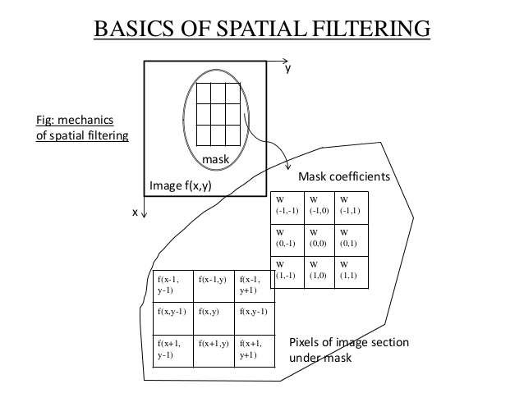
3*3 mask and the image section

Slide 15
Types Of Spatial Filters
There are two types of filter,
1.Linear Spatial Filter 2.Non Linear Spatial Filter
O Each pixel in an image can be replaced with constant value then it is called as linear spatial filter otherwise it is called as non-linear.

Slide 16
Linear vs Non-Linear Spatial Filtering Methods
A filtering method is linear when the output is a weighted sum of the input pixels.
Methods that do not satisfy the above property are called non-linear.
e.g.,

Slide 19
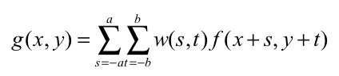
Spatial Filter Expression
O For m x n size of image,
we assume m=2a+1 & n=2b+1 where a,b are positive integers. so the linear spatial filter of image MxN with filter size mxn is by following expression.

Slide 21
Basics of Spatial Filtering
Mask operation near the image border
Problem arises when part of the mask is located outside the
image plane; to handle the problem:
1. Discard the problem pixels (e.g. 512x512input 510x510output, if mask size is 3x3)
2. Zero padding: expand the input image by padding zeros (512x512input 514x514output)
– Zero padding is not good; creates artificial lines or edges on the border
3. We normally use the gray levels of border pixels to fill up the expanded region (for 3x3 mask). For larger masks a border region equal to half of the mask size is mirrored on the expanded region.
1/15/2021
21

Slide 22
Strange Things Happen At The Edges!
At the edges of an image we are missing pixels to form a neighbourhood
Origin
x
e
e
e
e
e
e
e
y
Image f (x, y)
Notes:
22

Slide 23
Strange Things Happen At The Edges!
There are a few approaches to dealing with missing edge pixels:
Pad the image
Typically with either all white or all black pixels
Replicate border pixels
Truncate the image
Notes:
23

Slide 24
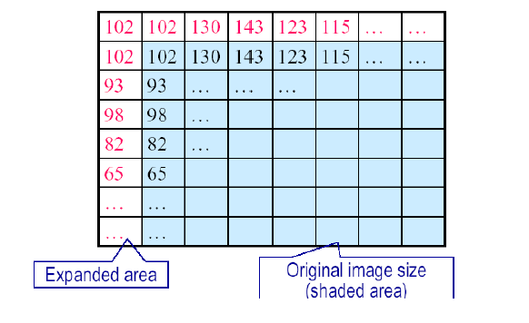
Mask Operation Near the Image Border

Slide 25
Spatial Correlation & Convolution
O Correlation is moving the filter over the image find the sum of products in each location.
O Convolution process is same as correlation but the filter is first rotate by 180 degree.

Slide 27
Correlation (cont’d)
Often used in applications where we need to measure the similarity between images or parts of images
(e.g., template matching).

Slide 28
Correlation & Convolution
The filtering we have been talking about so far is referred to as correlation with the filter itself referred to as the correlation kernel
Convolution is a similar operation, with just one subtle difference
For symmetric filters it makes no difference
a
b
c
r
s
t
d
e
e
*
u
v
w
e_{processed} = v*e + z*a + y*b + x*c + w*d + u*e + t*f + s*g + r*h
f
g
h
x
y
z
Original Image Pixels
Filter
Notes:
28

Slide 29
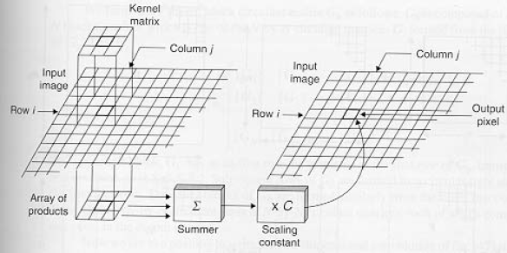
Correlation
w(i,j)
g(i,j)
Output
Image
f(i,j)

Slide 30
Convolution
Similar to correlation except that the mask is first flipped both horizontally and vertically.
Note: if w(i, j) is symmetric, that is w(i, j)=w(-i,-j), then convolution is equivalent to correlation!

Slide 31
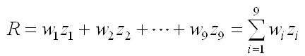
Vector Representation Of Linear Filtering
O The vector representation R should be formed for the linear filter as follows,
R = w1 z1+w2 z2+ -------- Wmn Zmn
O For example,
Here we rotate the mask by 180 ,this shown by 3x3 as follows,
w1 | w2 | w3
w4 | w5 | w6
w7 | w8 | w9

Slide 32
Smoothing Spatial Filters
OSmoothing filters are used for blurring and for noise reduction.
OBlurring is used as preprocessing such as removal of small details from image.
ONoise reduction is blurring with linear or non linear filter.

Slide 33
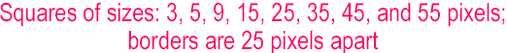
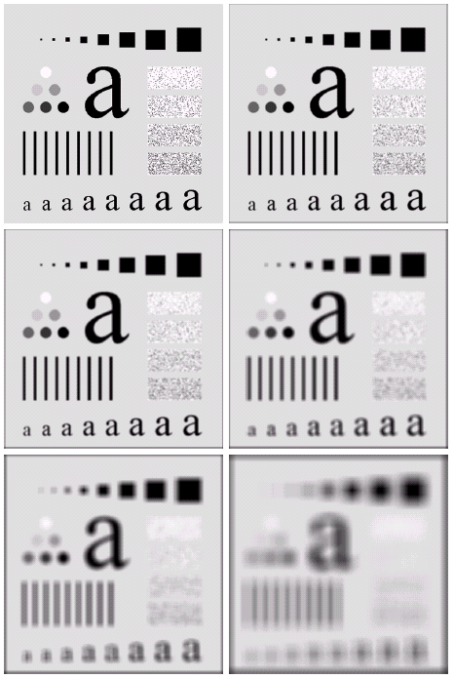
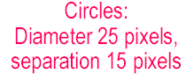
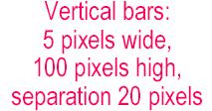


Spatial filtering for Smoothing (example)

Slide 34
Spatial filtering for Smoothing (example)
Original image size: 500 x 500
Smoothed by 3 x 3 box filter
Smoothed by 5 x 5 box filter
Smoothed by 9 x 9 box filter
Smoothed by 15 x 15 box filter
Smoothed by 35 x 35 box filter

Slide 35
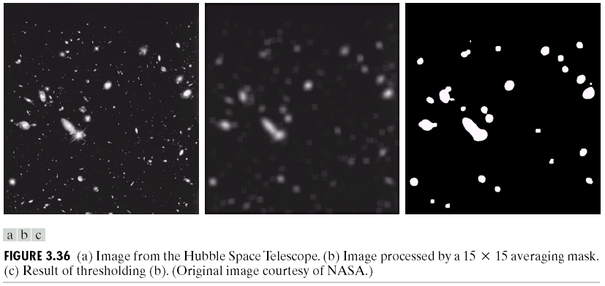
Spatial filtering for Smoothing (example)

Slide 36
TYPES OF SMOOTHING FREQUENCY FILTER
SMOOTHING FILTERS
NON-LINEAR FILTERS
LINEAR FILTERS
MEDIAN FILTERS
MINMAX FILTERS
AVERAGING FILTERS

Slide 37
Smoothing With Linear Filter
AVERAGING FILTER:
O The output of linear spatial filter computes the average of pixels is called averaging filter or low pass filter.
O
The major usage of average filter is reduction of irrelevant detail in an image.
1 | 1 | 1
1 | 1 | 1
1 | 1 | 1
1 | 2 | 1
2 | 4 | 2
1 | 2 | 1
1/9 x
1/16 x

Slide 38
Smoothing Spatial Filters
One of the simplest spatial filtering operations we can perform is a smoothing operation
Simply average all of the pixels in a neighbourhood around a central value
Especially useful in removing noise from images
Also useful for highlighting gross detail
¹/₉ | ¹/₉ | ¹/₉
¹/₉ | ¹/₉ | ¹/₉
¹/₉ | ¹/₉ | ¹/₉
Simple Averaging Filter
38
Notes:
38

Slide 39
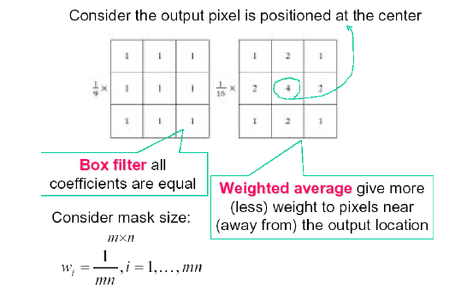
Smoothing Filters

Slide 40
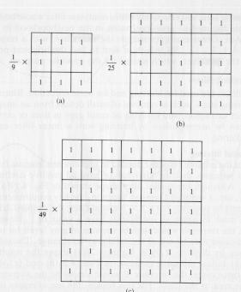
Smoothing Filters: Averaging

Slide 41
Smoothing Spatial Filtering
Origin
x
104
100
108
¹/₉
¹/₉
¹/₉
99
106
98
*
¹/₉
¹/₉
¹/₉
95
90
85
¹/₉
¹/₉
¹/₉
Original Image Pixels
Filter
¹/₉
¹/₉
¹/₉
Simple 3*3 Neighbourhood
104
100
108
3*3 Smoothing Filter
¹/₉
¹/₉
¹/₉
99
106
98
¹/₉
¹/₉
¹/₉
95
90
85
e = ¹/₉*106 + ¹/₉*104 + ¹/₉*100 + ¹/₉*108 + ¹/₉*99 + ¹/₉*98 + ¹/₉*95 + ¹/₉*90 + ¹/₉*85
= 98.3333
y
Image f (x, y)
The above is repeated for every pixel in the original image to generate the smoothed image
Notes:
41

Slide 42
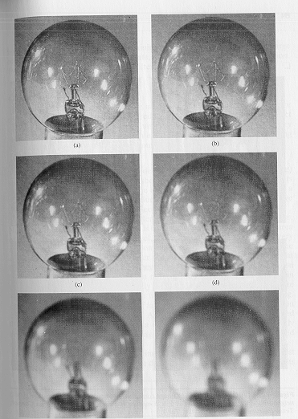
Smoothing Filters: Averaging (cont’d)
Mask size determines the degree of smoothing (loss of detail).
original
3x3
5x5
7x7
15x15
25x25

Slide 43
Weighted Smoothing Filters
More effective smoothing filters can be generated by allowing different pixels in the neighbourhood different weights in the averaging function
Pixels closer to the central pixel are more important
Often referred to as a weighted averaging
¹/₁₆ | ²/₁₆ | ¹/₁₆
²/₁₆ | ⁴/₁₆ | ²/₁₆
¹/₁₆ | ²/₁₆ | ¹/₁₆
Weighted Averaging Filter
Notes:
43

Slide 44
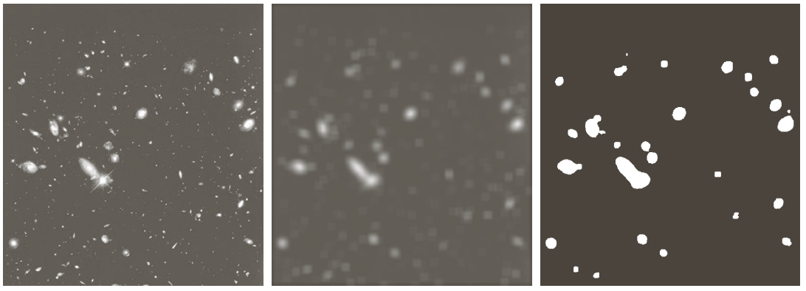
Smoothing Filters: Averaging (cont’d)
Example: extract largest, brightest objects
15 x 15 averaging
image thresholding

Slide 45
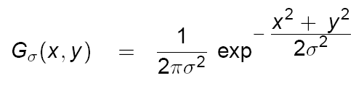
Smoothing filters: Gaussian
The weights are Gaussian samples:
σ = 1.4
mask size is
a function of σ:

Slide 46
Order-statistics filtering
Nonlinear spatial filters
Output is based on order of gray levels in the masked area (sub-image)
Examples: Median filtering, Max & Min filtering
Median filtering
Assigns the mid value of all the gray levels in the mask to the center of mask;
Particularly effective when
the noise pattern consists of strong, spiky components (impulse noise, salt-and-pepper
edges are to be preserved
Force points with distinct gray levels to be more like their neighbors

Slide 47
Non- Linear Spatial Filter(order Statistic Filter)
MEDIAN FILTER:
O This filter ordering the pixels by replacing the value of the center pixel with the value of rank list. The best known filter in this category is median filter. This is best for noise reduction.
O This median filter is effective for impulse noise called as salt & pepper noise.

Slide 48
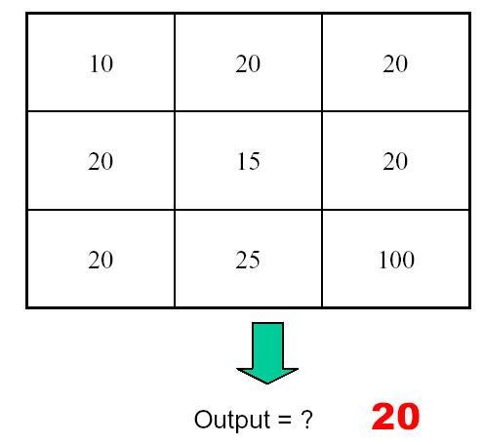
Median Filtering

Slide 49
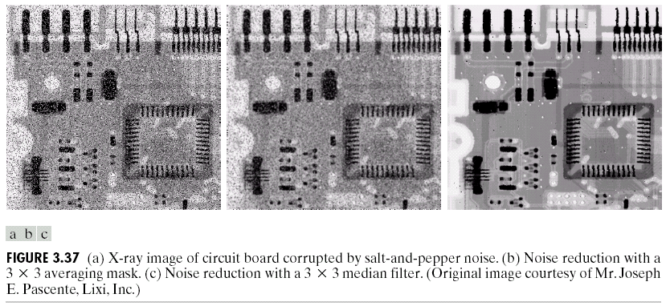
Median Filtering (example)

Slide 50
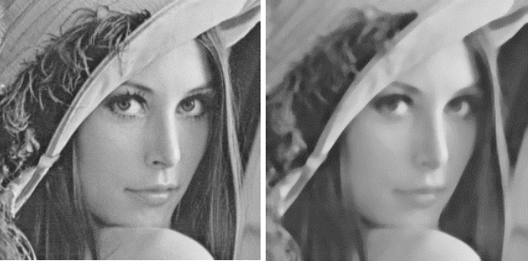
Median Filter Examples
input
Median 7X7

Slide 51
Median Filter Examples
Straight edges kept
Median 3X3
Median 11X11
Sharp features lost

Slide 52
Median Filter Properties
Can remove outliers (peppers and salts)
Window size controls size of structure
Preserve some details but sharp corners and edges might get lost

Slide 53
MAX FILTER:
O The max filter also used for spatial filtering.This is used for finding the brightest points of an image.
O Expression of max filter is
R=max {Zk| k= 1,2,3,…….9}

Slide 54
MIN FILTER:
The min filter also used it is opposite of max that is find the dull points of an image.
Expression of max filter is R=min{Zk| k= 1,2,3,…….9}

Slide 55
Smoothing filters: Gaussian
The weights are Gaussian samples:
σ = 1.4
mask size is
a function of σ:

Slide 56
Smoothing filters: Gaussian (cont’d)
σ controls the amount of smoothing
As σ increases, more samples must be obtained to represent
the Gaussian function accurately.
σ = 3

Slide 57
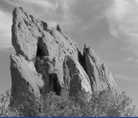
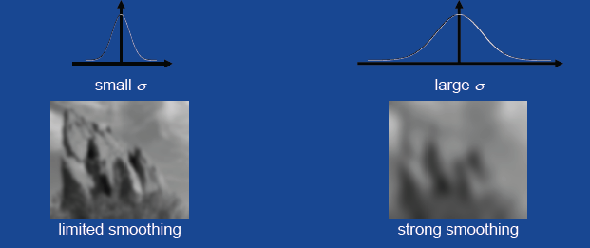
Smoothing filters: Gaussian (cont’d)

Slide 58
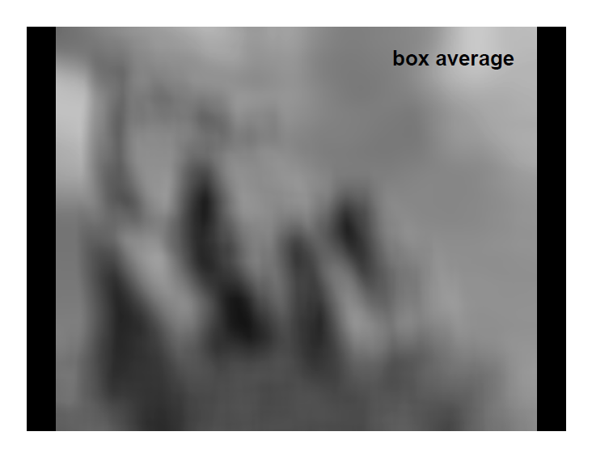
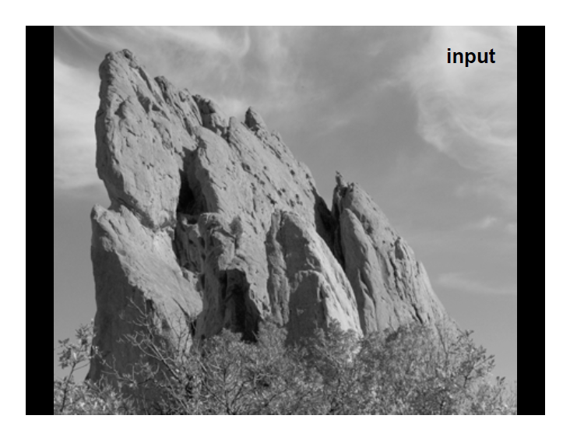
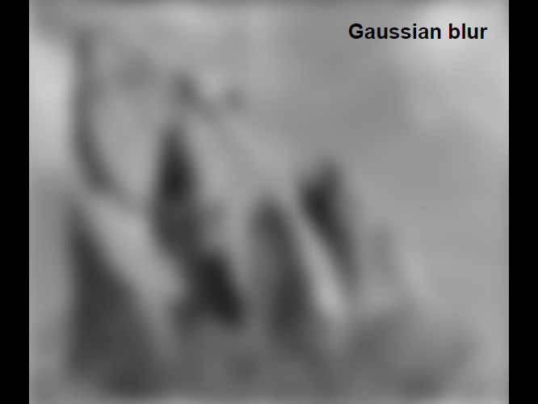
Averaging vs Gaussian Smoothing
Averaging
Gaussian

Slide 59
Comparison of Mean, Gaussian, and Median
original
Mean with 6 pixels

Slide 60
Comparison of Mean, Gaussian, and Median
original
Gaussian with 6 pixels

Slide 61
Comparison of Mean, Gaussian, and Median
original
Median with 6 pixels

Slide 62
Common Problems
Mean: blurs image, removes simple noise, no details are preserved
Gaussian: blurs image, preserves details only for small σ.
Median: preserves some details, good at removing strong noise
Notes:
pr

Slide 63
Spatial filtering for image sharpening
Background: to highlight fine detail in an image or to enhance blurred detail
Applications: electronic printing, medical imaging, industrial inspection, autonomous target detection (smart weapons)......
Foundation:
Blurring/smoothing is performed by spatial averaging (equivalent to integration)
Sharpening is performed by noting only the gray level changes in the image that is the differentiation

Slide 64
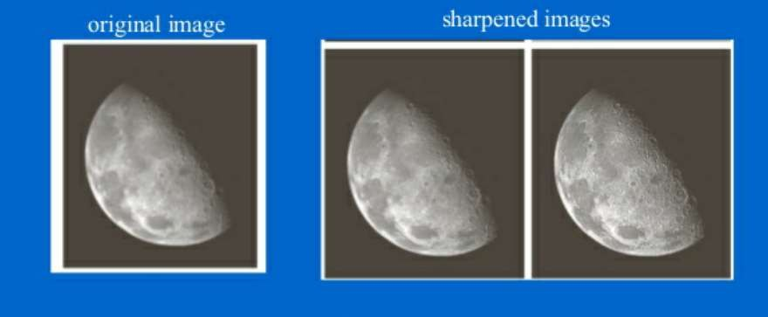

Slide 65
Spatial filtering for image sharpening
Operation of Image Differentiation
Enhance edges and discontinuities (magnitude of output gray level >>0)
De-emphasize areas with slowly varying gray-level values (output gray level: 0)
Mathematical Basis of Filtering for Image Sharpening
First-order and second-order derivatives
Approximation in discrete-space domain
Implementation by mask filtering

Slide 66
Derivatives
First Order Derivative
A basic definition of the first-order derivative of a one-dimensional function f(x) is the difference
Second Order Derivative
Similarly, we define the second-order derivative of a one-dimensional function f(x) is the difference

Slide 67
Derivatives
First derivative
Second derivative

Slide 68
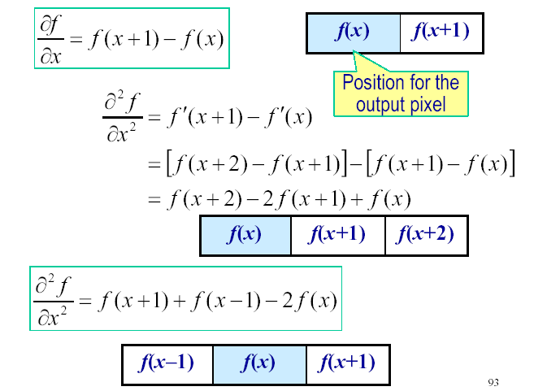
First and second order derivatives

Slide 69
Comparison between f" and f´
f´ generally produces thicker edges in an image
f" has a stronger response to fine detail
f´ generally has a stronger response to a gray-level step
f" produces a double response at step changes in gray level
For image enhancement, f" is generally better suited
than f´
Major application of f´ is for edge extraction; f´ used together with f" results in impressive enhancement effect

Slide 70
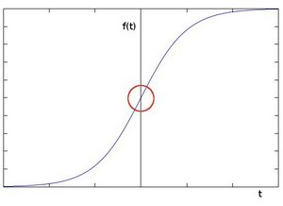
let's assume we have a 1D-image. An edge is shown by the "jump" in intensity in the plot below:

Slide 71
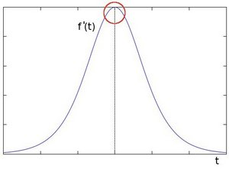
The edge "jump" can be seen more easily if we take the first derivative

Slide 72
Sharpening Filters
Unsharp masking
High Boost filter
Gradient (1st derivative)
Laplacian (2nd derivative)

Slide 73
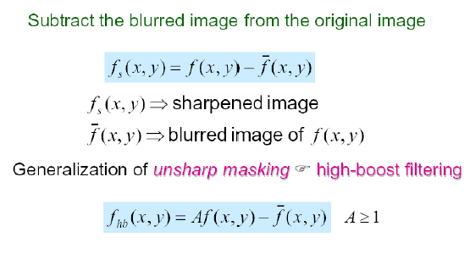
Image Sharpening Based on Unsharp Masking

Slide 74



Sharpening Filters: Unsharp Masking
Obtain a sharp image by subtracting a lowpass filtered (i.e., smoothed) image from the original image:
-
=
(after contrast
enhancement)

Slide 75
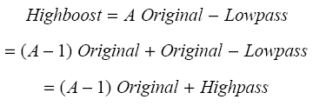

Sharpening Filters: High Boost
Image sharpening emphasizes edges but low frequency components are lost.
High boost filter: amplify input image, then subtract a lowpass image.
(A-1)
+
=

Slide 76
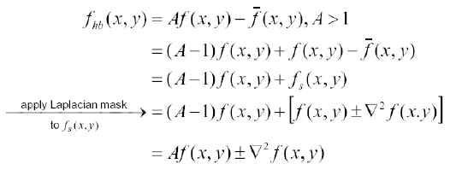
High Boost Filtering
Principal application:
Boost filtering is used when input image is darker than desired,
high-boost filter makes the image lighter and more natural

Slide 77
Sharpening Filters: High Boost (cont’d)
If A=1, we get unsharp masking.
If A>1, part of the original image is added back to the high pass filtered image.
One way to implement high boost filtering is using the masks below:

Slide 78
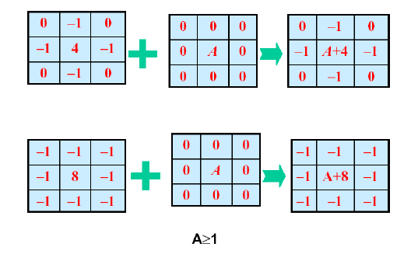
High Boost Filtering Masks

Slide 79

Sharpening Filters: High Boost (cont’d)
A=1.4
A=1.9

Slide 80
1st Derivative Filtering
Implementing 1st derivative filters is difficult in practice
For a function f (x, y) the gradient of f at coordinates (x, y) is given as the column vector:
Notes:
80

Slide 81
Gradient
The gradient is a vector which has magnitude and direction:
(approximation)
or

Slide 82
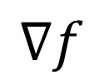
Gradient (cont’d)
Gradient magnitude: provides information about edge strength.
Gradient direction: perpendicular to the direction of the edge.

Slide 83
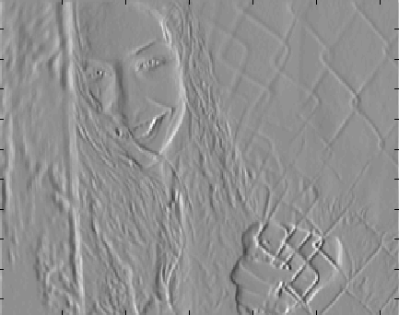
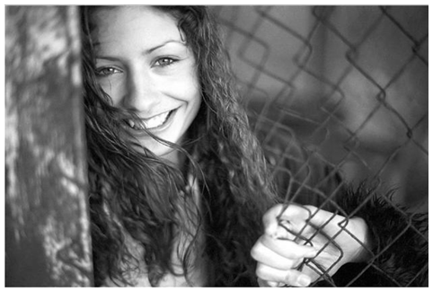
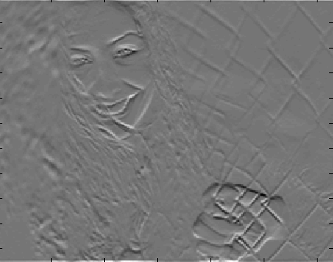
Example: visualize partial derivatives

Slide 84
1st Derivative Filtering (cont…)
Now we want to define digital approximations and their Filter Masks
For simplicity we use a 3x3 region
For example z₅ denotes f(x,y), z₁ denotes f(x-1,y-1)
A simple approximation for First Derivative is
z₁
z₂
z₃
z₄
z₅
z₆
z₇
z₈
z₉

Slide 85
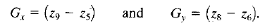
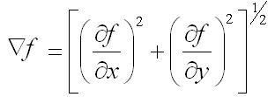
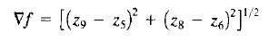
1st Derivative Filtering (cont…)
A simple approximation for First Derivative is
Two other definitions proposed by Roberts use cross- difference
z₁
z₂
z₃
If we use
z₄
z₅
z₆
z₇
z₈
z₉

Slide 86
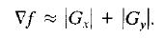
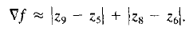
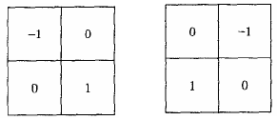
1st Derivative Filtering (cont…)
If we use absolute values then
z₁
z₂
z₃
z₄
z₅
z₆
z₇
z₈
z₉
The Masks corresponding to these equations are:
Roberts Cross-Gradient Operators

Slide 87
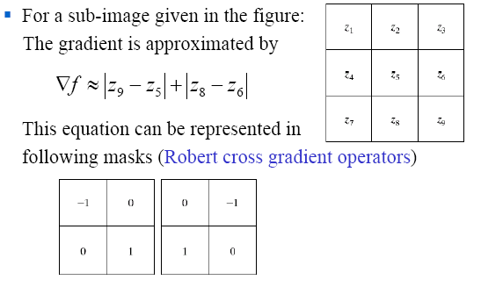
Gradient Operators

Slide 88
Implement Gradient Using Masks (cont’d)
Other approximations
Prewitt
Sobel

Slide 89
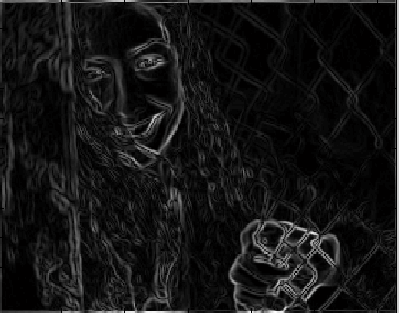
Example: Gradient Magnitude Image
Gradient Magnitude
(isotropic)

Slide 90
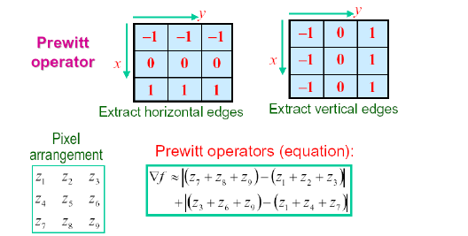
Gradient Operators
Normally the smallest mask used is of size 3 x 3
Based on the concept of approximating the gradient several spatial masks have been proposed:

Slide 91
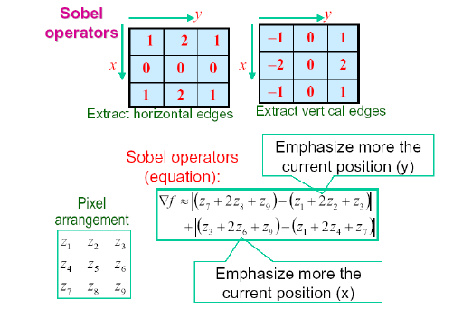
Gradient Operators

Slide 92
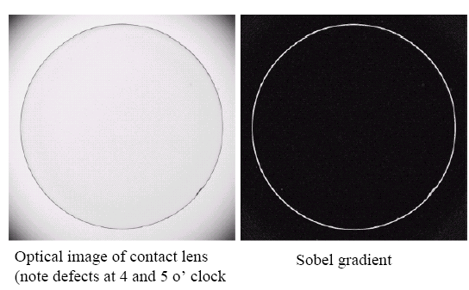
Gradient Processing (Example)

Slide 93
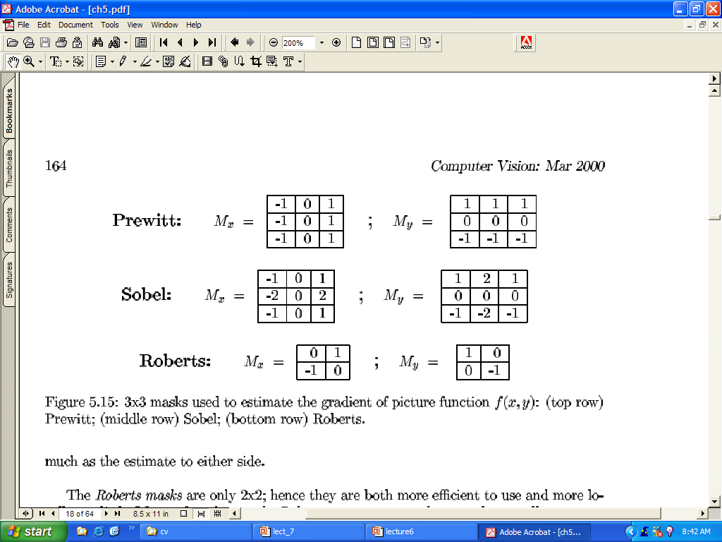
Mask used to estimate the Gradient

Slide 94

Laplacian for image enhancement

Slide 95

Laplacian for Image Enhancement

Slide 96

Laplacian for image enhancement

Slide 97

Sharpening Filters - Example
Note that the response of sharpening might be negative.
Values must be re-mapped to [0, 255]
input image
sharpened image

Slide 98

Laplacian for image enhancement (example)

Slide 99



Example: Laplacian vs Gradient
Laplacian
Sobel

Slide 100

Combining Spatial Enhancement Methods (cont…)
(a)
Laplacian filter of bone scan (a)
(b)
Sharpened version of bone scan achieved by subtracting (a) and (b)
(c)
Sobel filter of bone scan (a)
(d)
Notes:
100

Slide 101

Combining Spatial Enhancement Methods (cont…)
Result of applying a power-law trans. to (g)
(h)
Sharpened image which is sum of (a) and (f)
(g)
The product of (c) and (e) which will be used as a mask
(f)
(e)
Image (d) smoothed with a 5*5 averaging filter
Notes:
101

Slide 102
Combining Spatial Enhancement Methods (cont…)
Compare the Original and Final Images
Notes:
102

Slide 103



